Slide 1


EPICS REVIEW 2024
Problem Statement Title : IOVsion Stick
Idea Title : Essential Guide to Build stick mystery
Team Name : Code Breakers
Theme : Smart Guidance

Slide 2
Team Details
Team Name : Code Breakers
College Name :Karpagam Institute Of Technology
Varun S Male III IT 6381649541 21ita60@karpagamtech.ac.in
Karthikeyan P Male III IT 7810086132 21ita19@karpagamtech.ac.in
Praveen K Male III IT 8015445170 21ita38@karpagamtech.ac.in

Slide 3
Problem Description
Visually impaired individuals face challenges in navigating their surroundings, identifying obstacles, and maintaining their independence.
Many public spaces and transportation systems lack proper accessibility features, making it challenging for visually challenged individuals to navigate and travel independently.

Slide 4
Your Idea
A Smart Blind Stick could revolutionize mobility assistance for visually impaired individuals by integrating advanced technology. Here are some features and concepts for such a device:
Obstacle Detection: Utilize ultrasonic sensors or cameras to detect obstacles in the user's path. The stick could then provide haptic feedback, such as vibrations, to alert the user of obstacles.

Slide 5
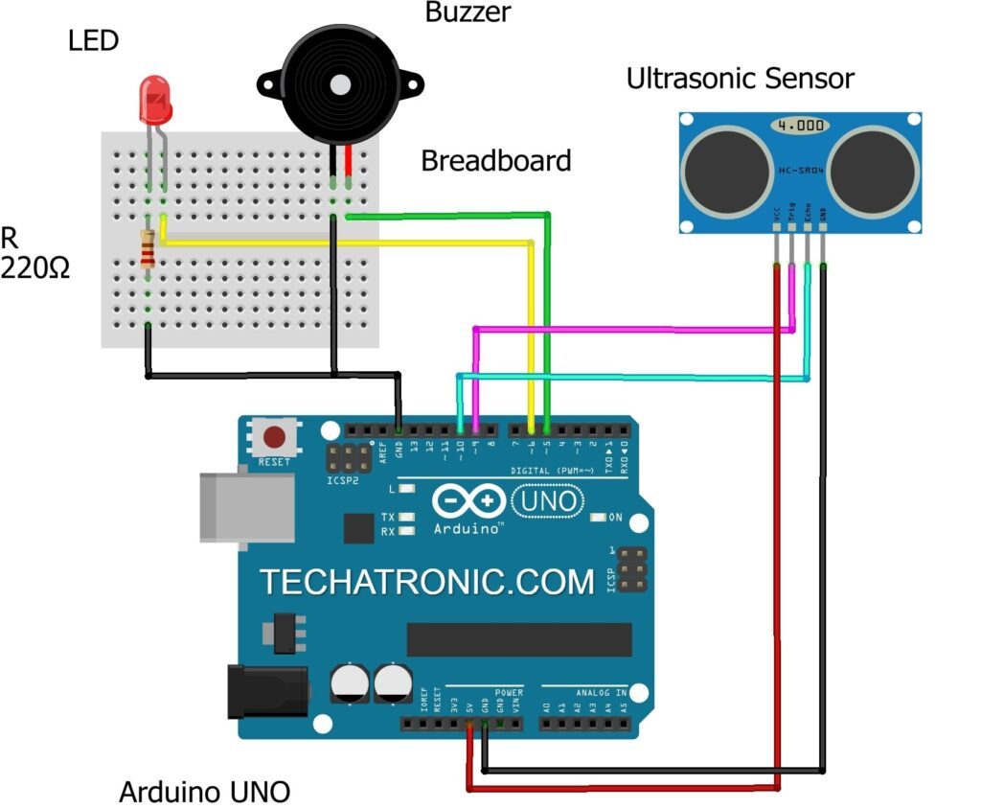
Pictorial Representation of the Idea
Block Diagram

Slide 6
Technology Stack
Power supply
•Ultrasonic sensor
•Water sensor
•buzzer
software = Arduino IDE
•language = embedded C.

Slide 7
Implementation
const int trigPin = D3;
const int echoPin = D2;
int buzzer = D0;
long duration;
int distanceCm, distanceInch;
int rain = D6;
int button = D1;
void setup()
{
Serial.begin(9600);
pinMode(trigPin, OUTPUT);
pinMode(echoPin, INPUT);
pinMode(buzzer,OUTPUT);
pinMode(rain,INPUT);
pinMode(button,INPUT);
}

Slide 8
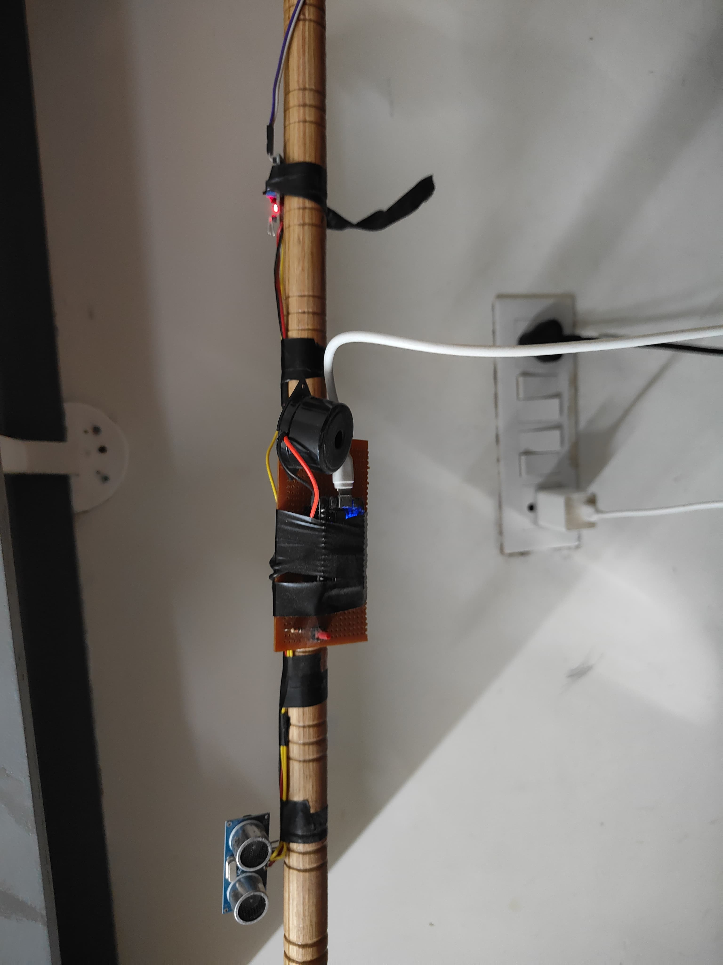
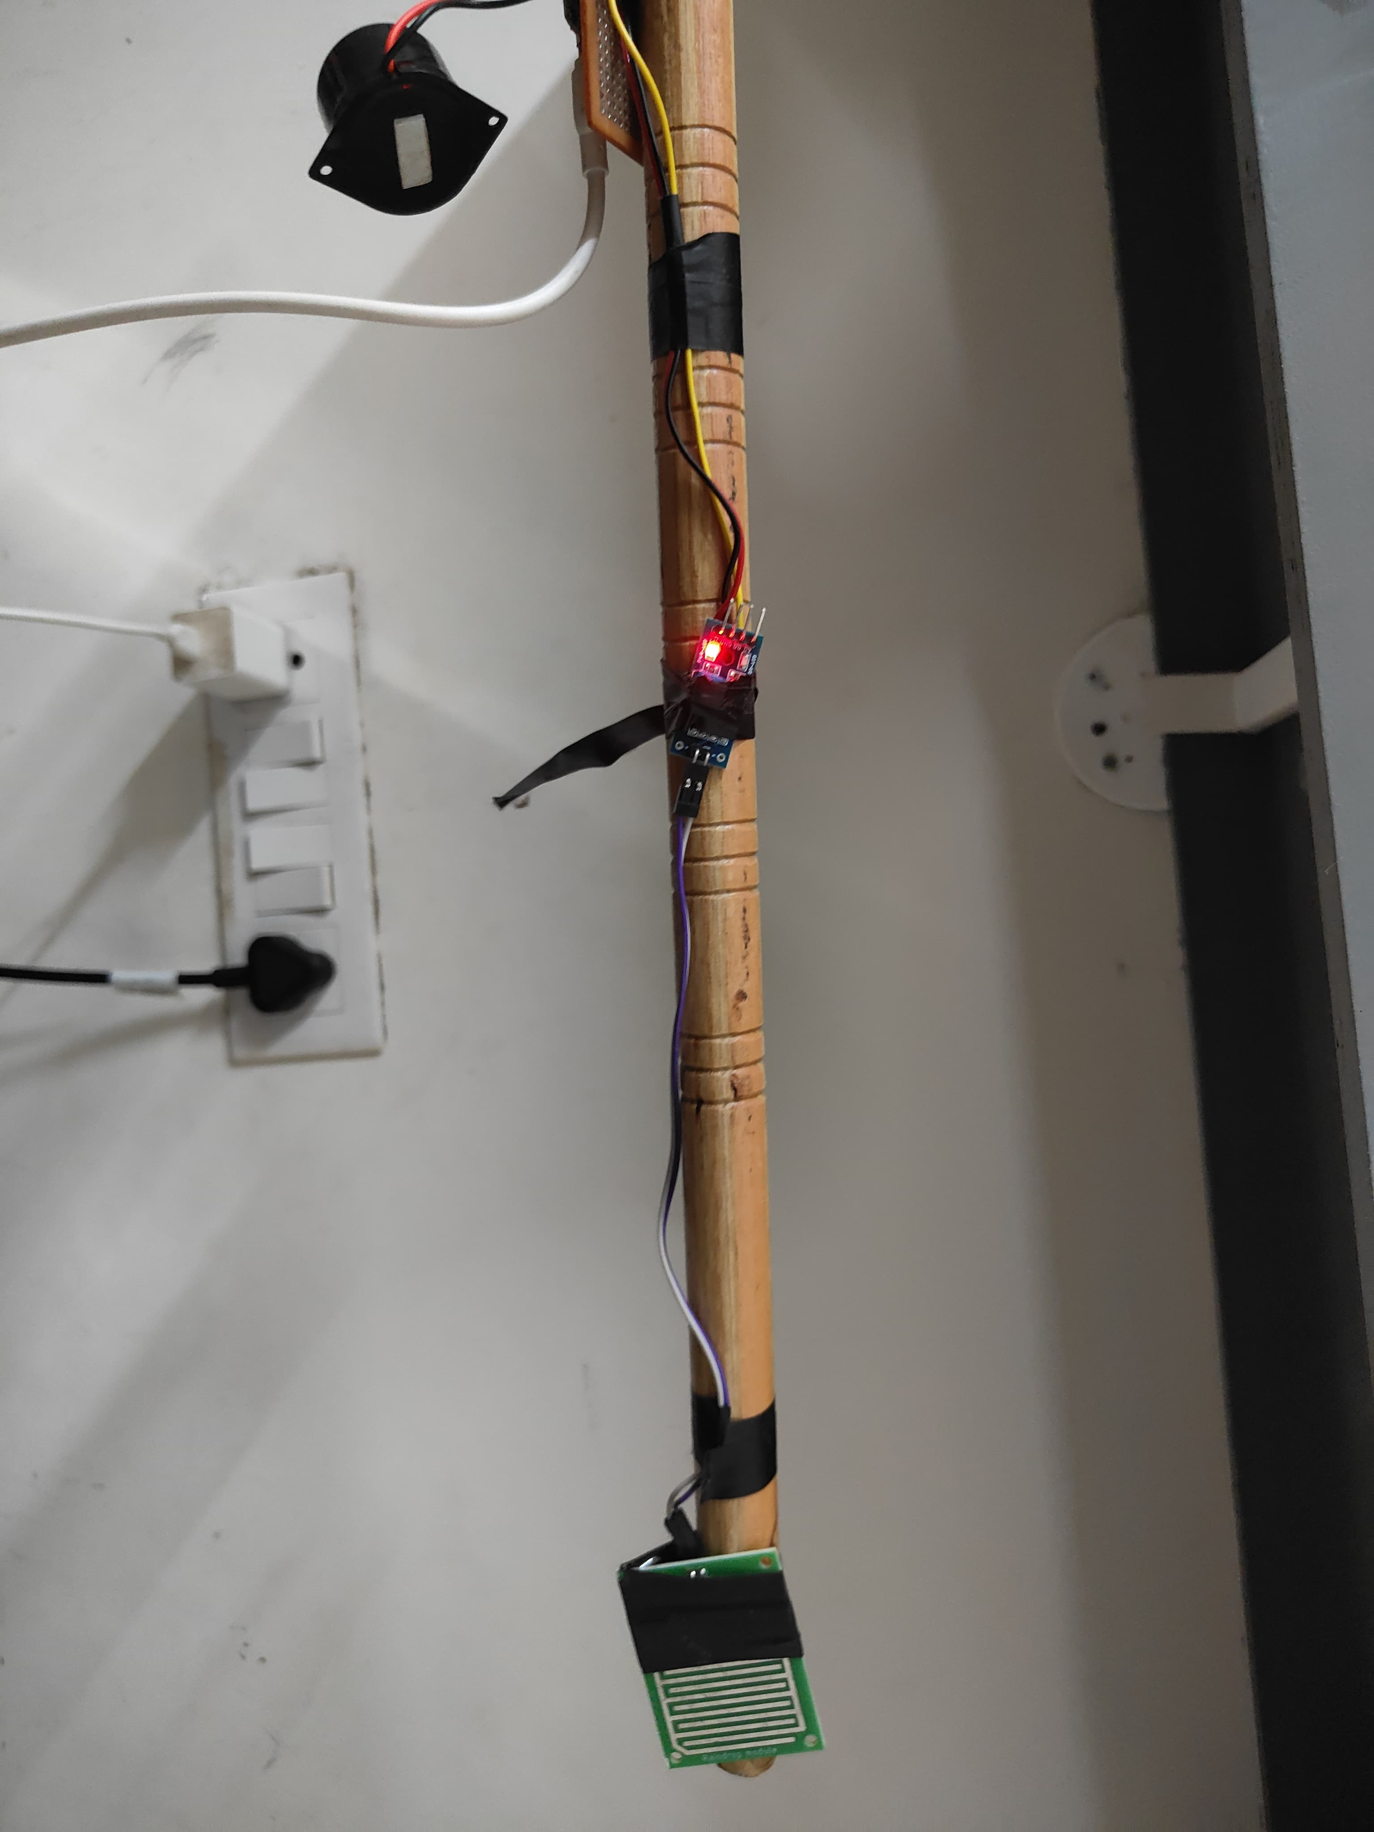
Demo/Output

Slide 9
Social Benefits
Accessibility
Safety
Empowerment
Independence

Slide 10
Commercial Viability
Startup idea:
Develop a unique IOVision Stick prototype with advanced features and user-friendly design, prioritizing feedback-driven iterations.
Forge strategic partnerships with healthcare providers, assistive technology organizations, and retail channels for widespread distribution.

